Slide 1



Multimedia & Graphics
Class VI
lab 14

Slide 2
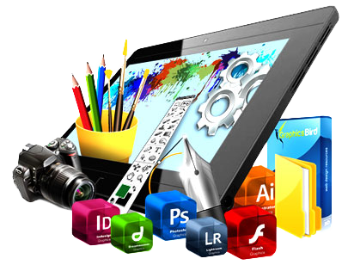

What is Sketchpad ?
an online painting tool.
You can perform various types of design using sketchpad

Slide 3
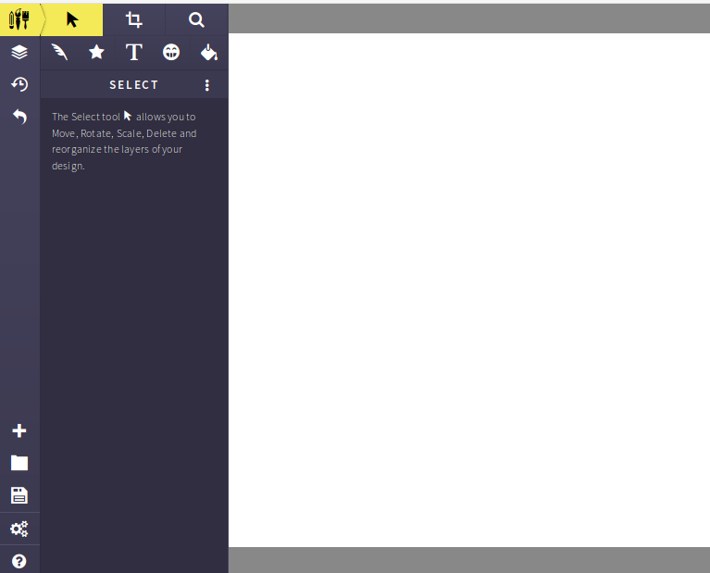
Jump into sketchpad
Open your web browser and go to
https://sketch.io/sketchpad/

Slide 4
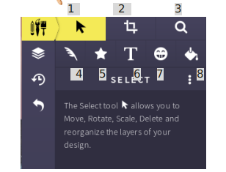
Sketchpad Toolbox
1.Select Tool
2.Crop Tool
3.Zoom Tool
4.Brush Tool
5.Shape Tool
6.Text Tool
7.Clip art
8.Vector Tool

Slide 5
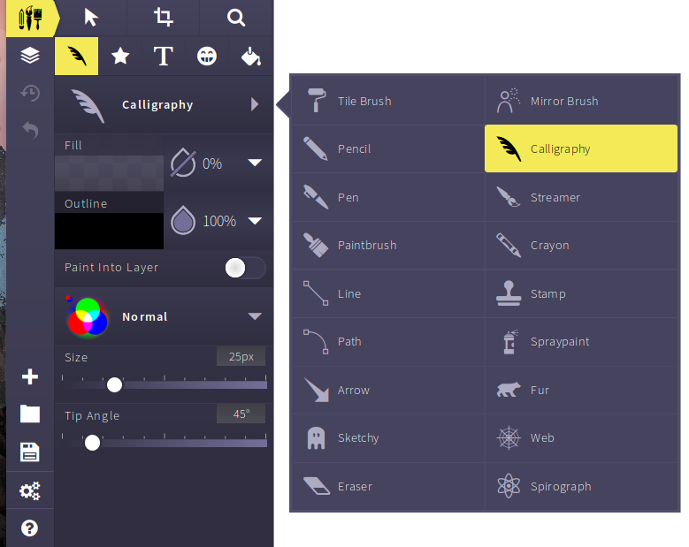
Brush Tools
the brush tool is an element of the painting tool that allows you to select a brush shape like square, circle, oval and so on

Slide 6
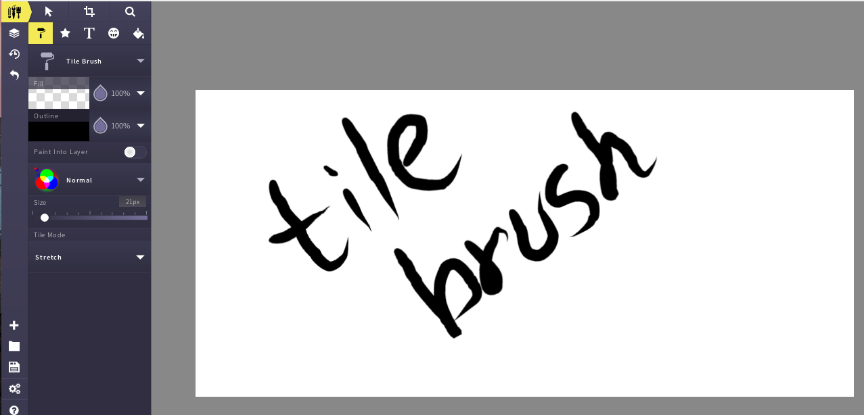
Brush Tools (Tile)

Slide 7
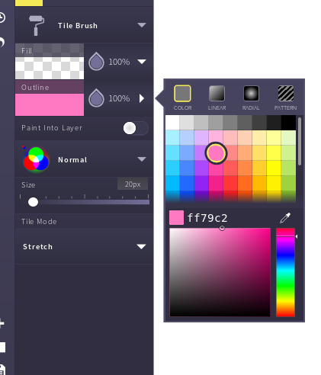

Adding Color

Slide 8
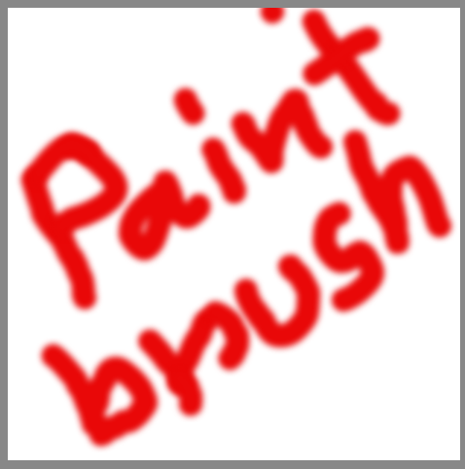
Paint Brush

Slide 9

Calligraphy

Slide 10



